Slide 2


Analysis of FPAs in the LHC RB circuit
Christoph Obermair, TE-MPE-CB Lukas Felsberger, TE-MPE-MI Franz Pernkopf, TU-Graz Andrea Apollonio, TE-MPE-CB Daniel Wollmann, TE-MPE-CB

Slide 3
Todays Goal
Status update
I will be at my University from September – October
Many ideas: What would be most interesting for you?
Additional ideas?

Slide 4
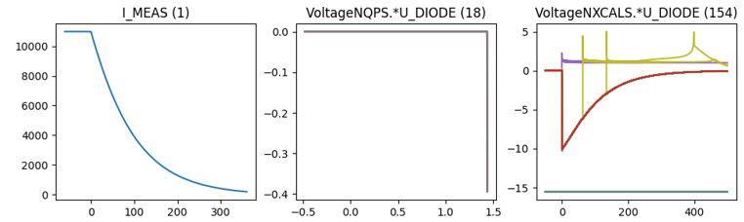
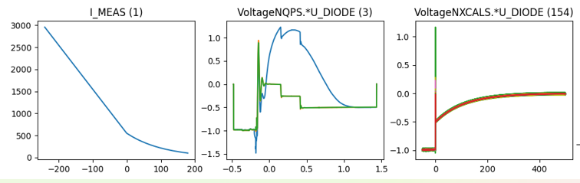
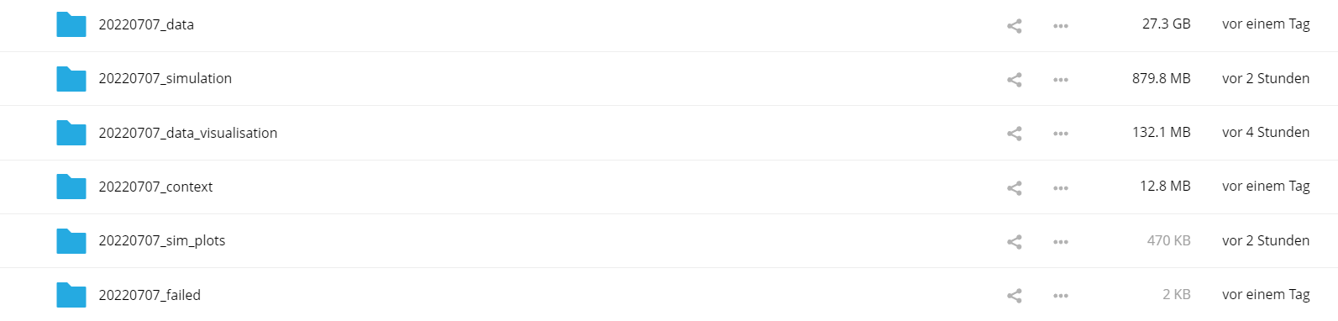
Existing Database Overview
Data overview
Filtered events
 | Signal | 2014-2020 | 2021 | # events
Real Data | U_DIODE_NXCALS | P | P | 867
 | U_DIODE_PM | P | P | 629
 | I_MEAS | P | P | 896
 | U_QSO, U_1, U_2 | P | P | 893
 | I_EATH_PCNT | P | P | 895
 | I_EARTH | P | P | 629
 | I_HDS, U_HDS | P | P | 896
 | EEUDumpResPM | P | P | 896
Simulations | V(0v_magf*) | P | P | 875
 | I(r1_warm) | P | P | 875
 | V(10,11), V(18,19) | P | P | 875
#events |  | 267 | 629 | 560/896
Database stored at EOS ml-for-alarm-system/private/RB_signals

Slide 5
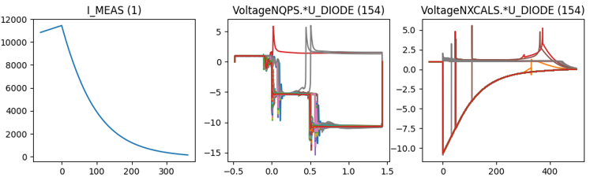
Creating Datasets
For further processing, data must be:
Contain the same phenomenon: Drop signals of quenched magnets
Filtered: Drop signals with wrong data
Aligned: Energy extraction must start at the correct time
Merged: Fit simulations to real data
Cropped: All events must have same length/index

Slide 6
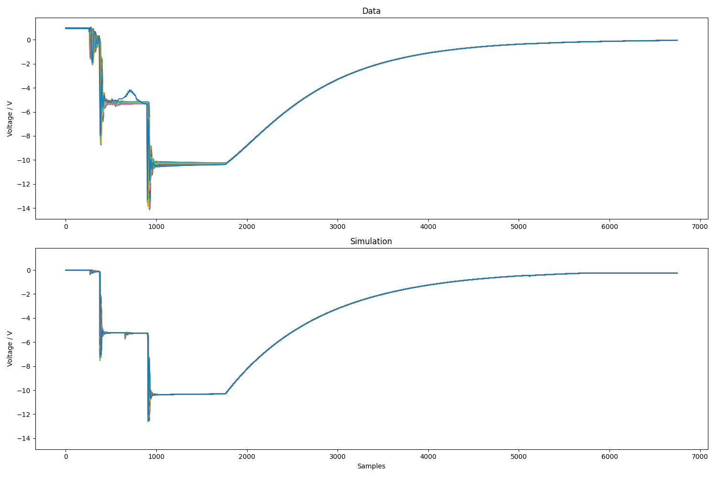
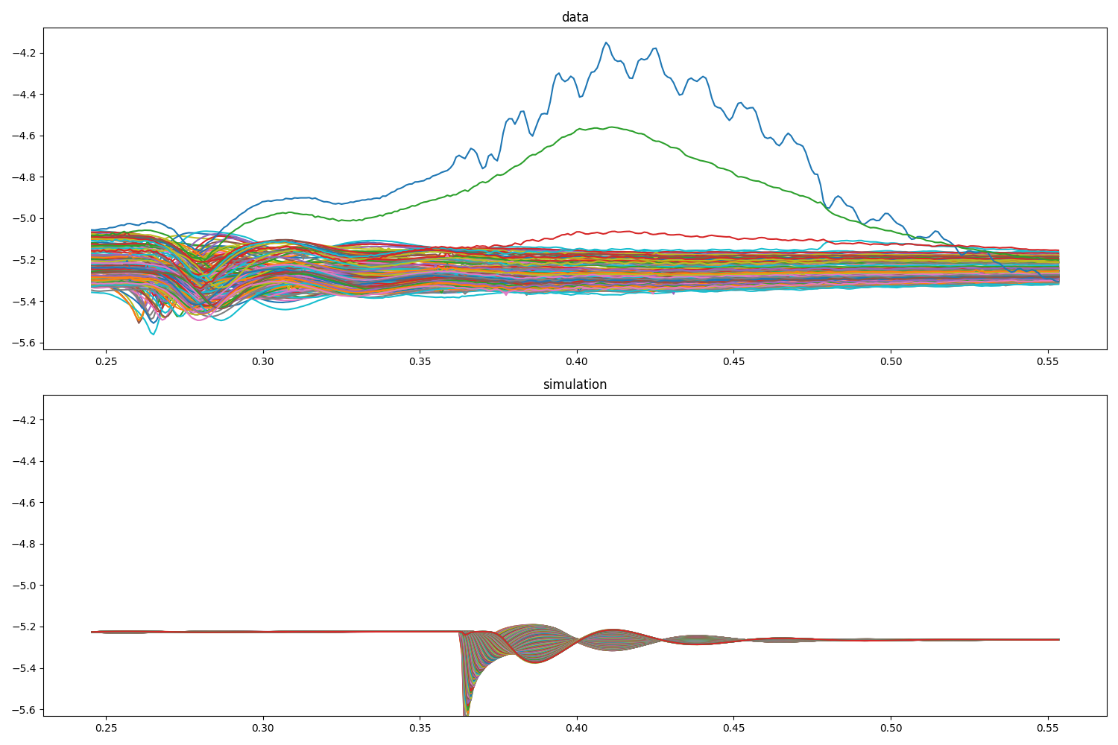
Dataset Examples
Example: U_diode_PM + U_diode_NXCALS U_diode_PM plateau

Slide 7

Overview of Data-Driven Models
High incorporation of knowledge and context
Data-Driven Models
Manual Feature Engineering
Manual Threshold
Probabilistic
Classic Machine Learning
Automatic Feature Eningeering
Discriminative Deep Learning
Generative Deep Learning
GAN, RNN, ProtoNET
MLP, DCNN, FCN
SVM, Random Forrest, MLP
e.g. Busbar Resistance
e.g. QH Analysis
Fully data driven
Physical Models
 | 1. Feature analysis | 2. Find probabilities | 3. Finding concepts | 4. Predict parameters | 5. Generate data
Goal | Classification of oscillations after secondary quenches | a.) Sunglasses: Effect threshold to #quenches. b.) P(sec. Quench| pos.) c.) Wiggle: How does the dstd score evolve in B28L8, compared to other magnets | Find different concepts of different anomalies in data | a.) Neural netlist optimization b.) Sec. Quench prediction | Can ML generate data faster/more accurate than simulations? Using the same input
Algorithm | Thresholds |  | tSNE, k-means | Neural Networks | Autoencoder
Dataset | U_diode: Window after sec. quench | U_diode: First ee plateau | U_diode: PM+NXCALS | U_diode: PM+NXCALS | U_diode: PM+NXCALS

Slide 8
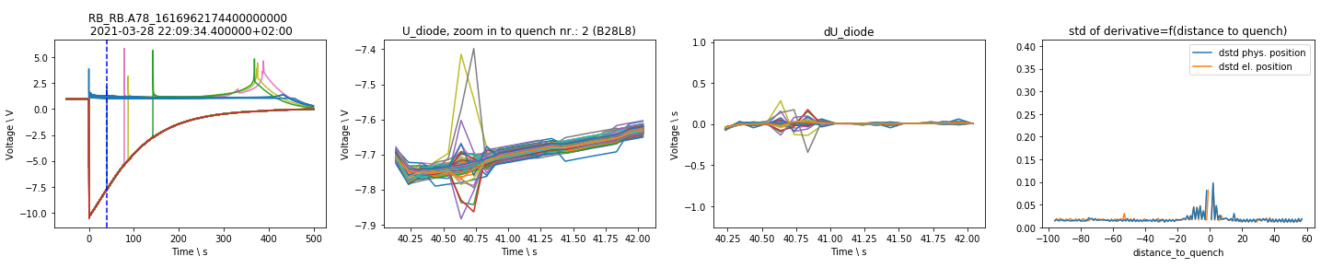
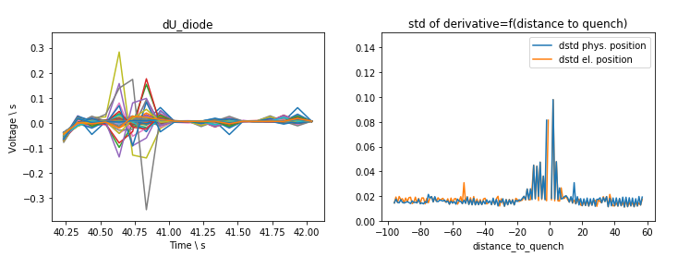
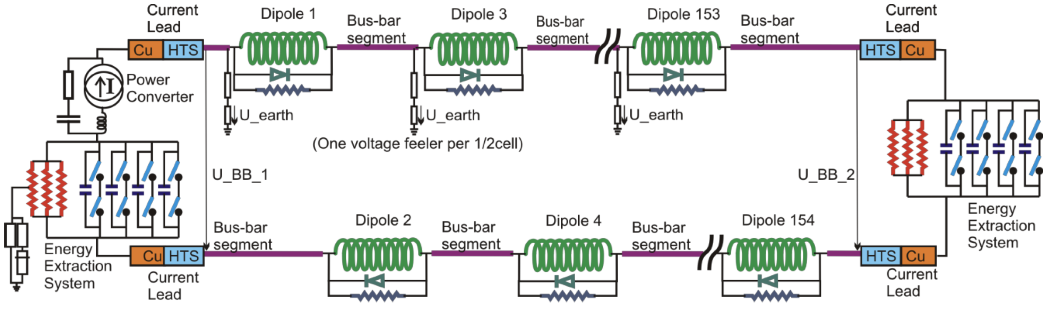
Feature analysis
Classification of oscillations after secondary quenches
-2
0
150
-1
1
151

Slide 9
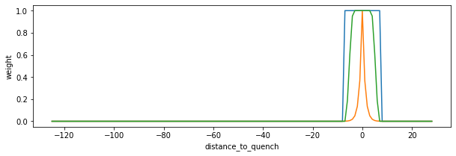
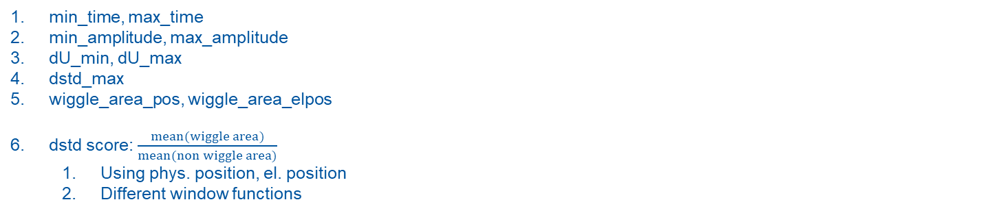
Features of secondary quench
2
3
4
2
3
1
min_time, max_time
min_amplitude, max_amplitude
dU_min, dU_max
dstd_max
wiggle_area_pos, wiggle_area_elpos
dstd score: $\frac{mean(wiggle area)}{mean(non wiggle area)}$
Using phys. position, el. position
Different window functions
5
5

Slide 10
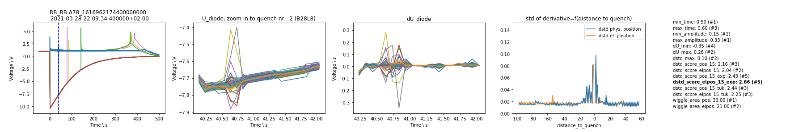
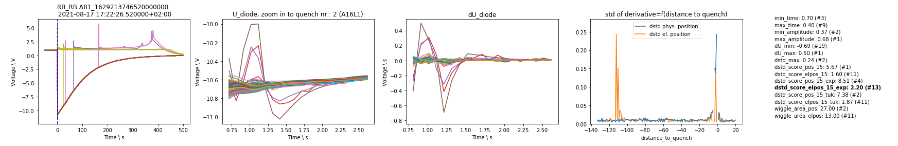
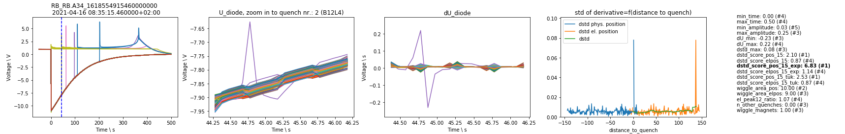
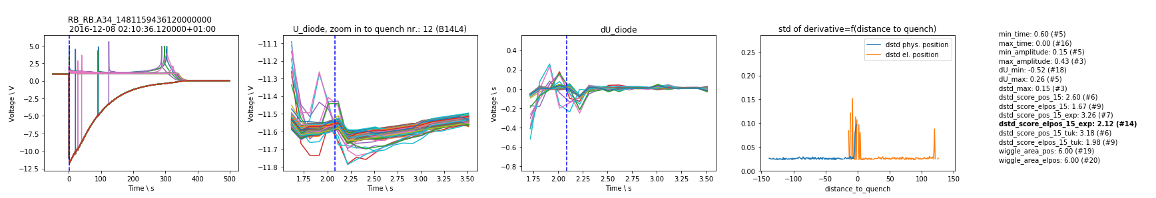
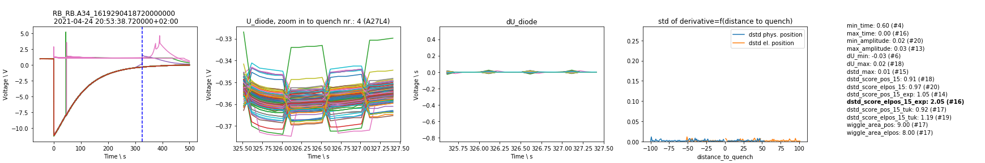
1. Oscillation that only propagates electrically
Reason: electric coupling?
2. Oscillation that propagates physically and electrically
Reason: electric coupling through grounding?
Special case: Oscillation in only one magnet
3. Oscillation due to another quench in time window
Reason: coupling of magnets
4. Oscillation due to acquisition
Reason: acquisition

Slide 11
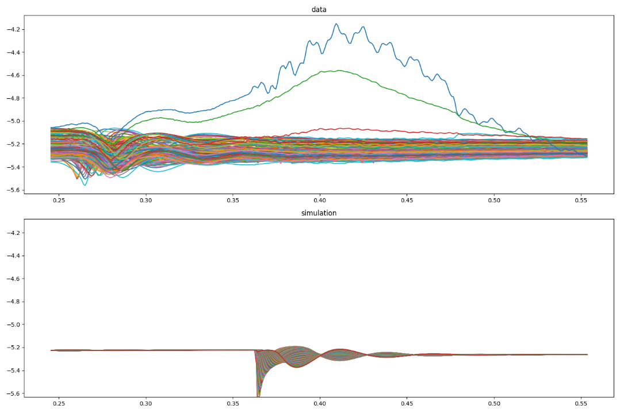
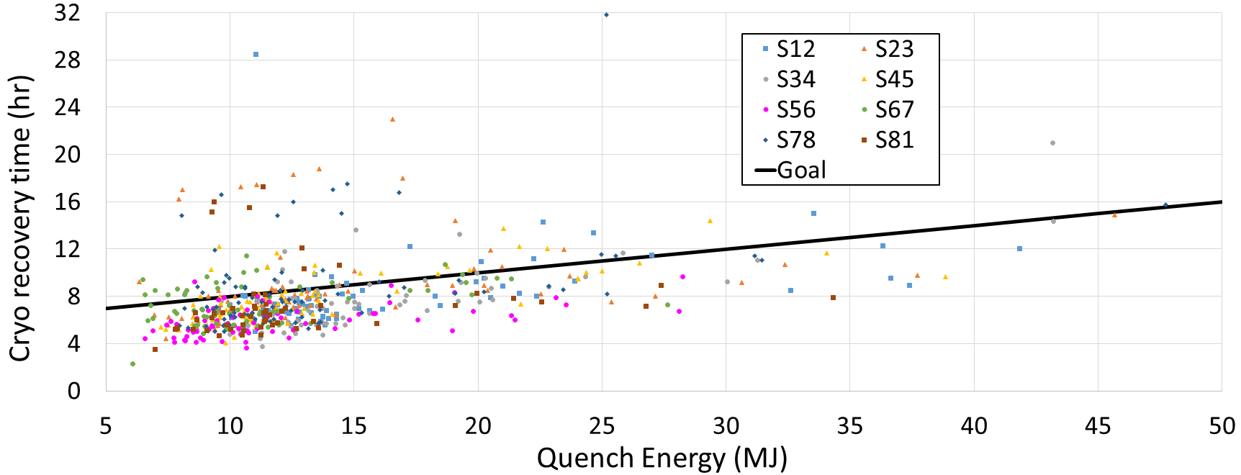
2. Find Probabilities
a.) Sunglasses: Effect threshold to #quenches.
b.) P(sec. Quench| position, time, energy) + Outliers
c.) Wiggle: How does the dstd score evolve in B28L8, compared to other magnets

Slide 12
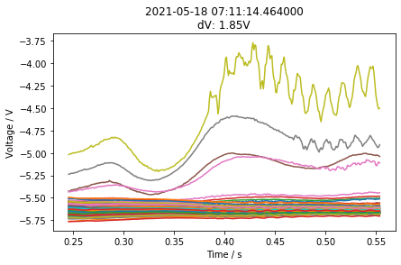
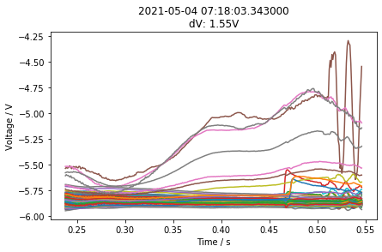
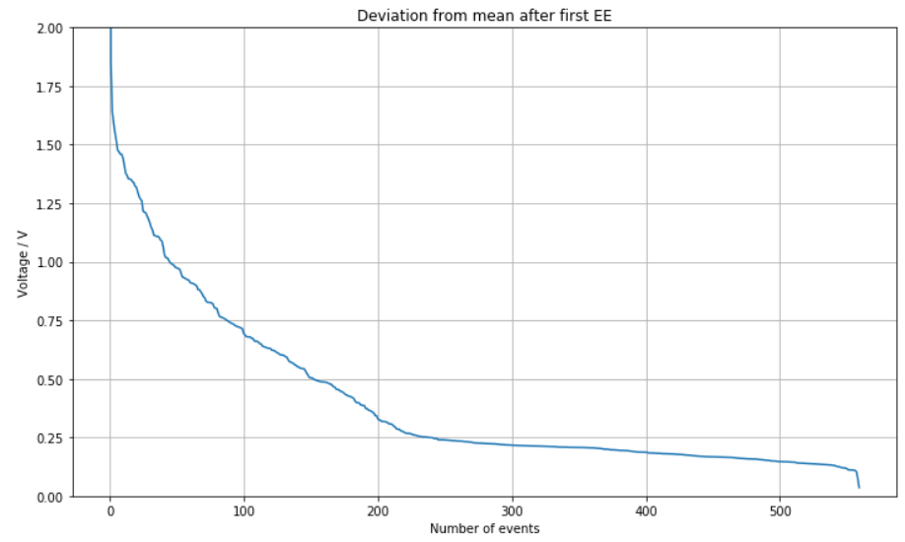
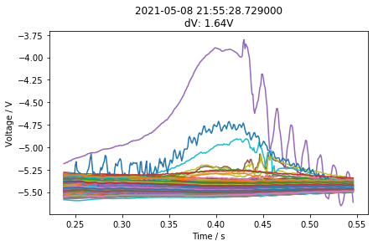
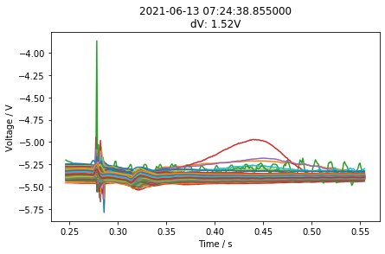
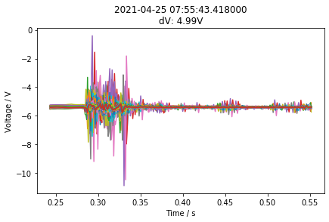
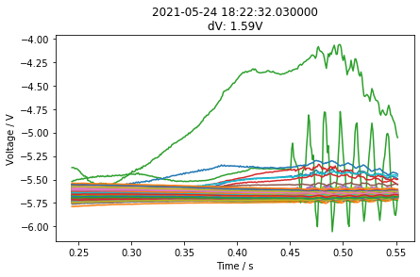
2. Find Probabilities
a.) Sunglasses: Effect threshold to #quenches.
How many samples must be above thresholds?

Slide 13
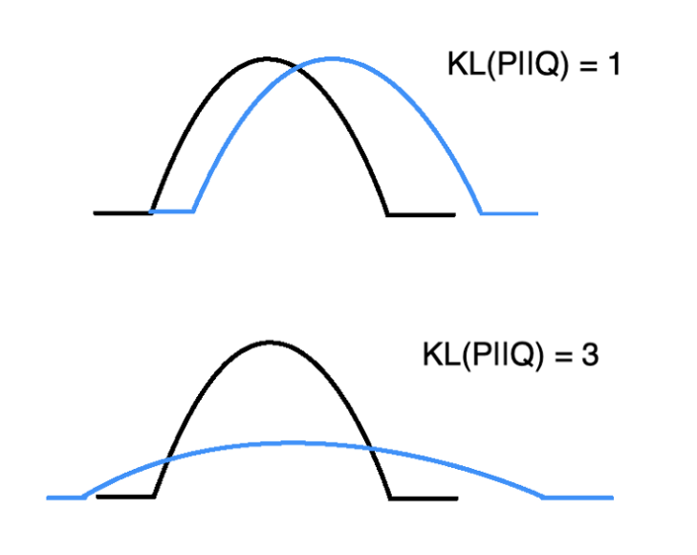
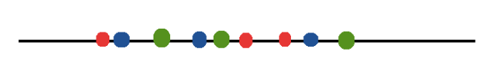
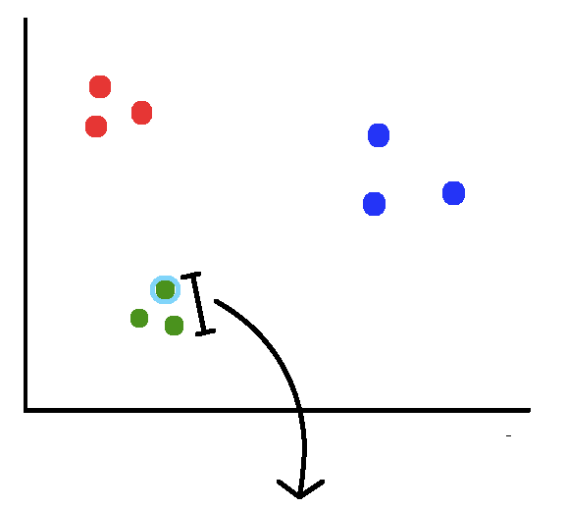
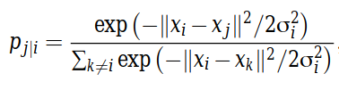
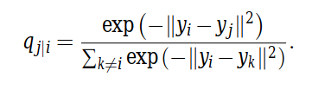
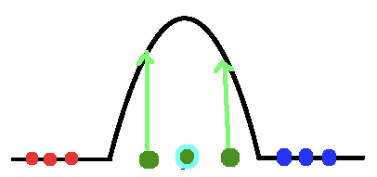
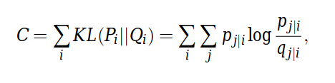
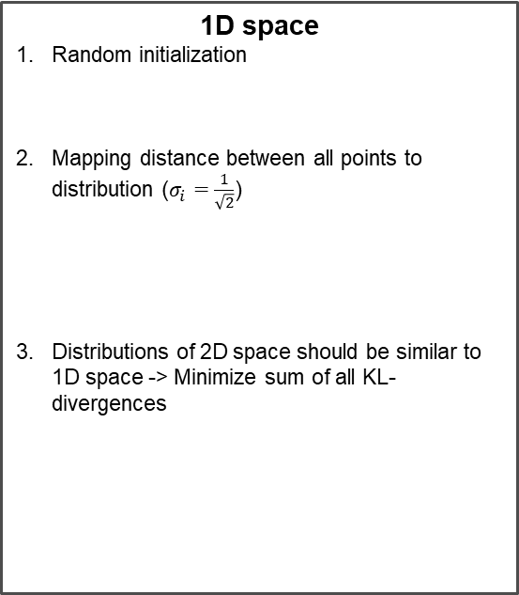

3. Finding concepts – tSNE overview
Example: Project 2D space to 1D space
2D space
1. Mapping distance between all points to distribution
1D space
Random initialization
Mapping distance between all points to distribution ($σ_{i}=\frac{1}{\sqrt{2}}$)
Distributions of 2D space should be similar to 1D space -> Minimize sum of all KL-divergences
KL-divergence
$$min⁡C$$

Slide 14
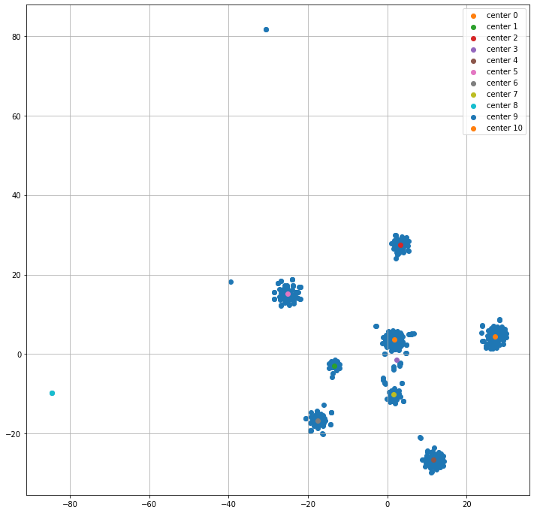
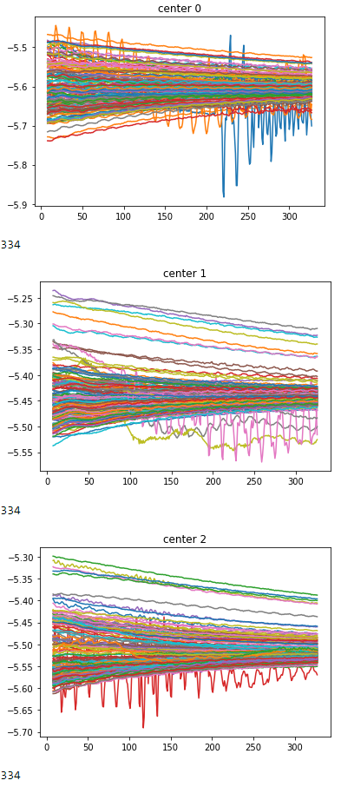
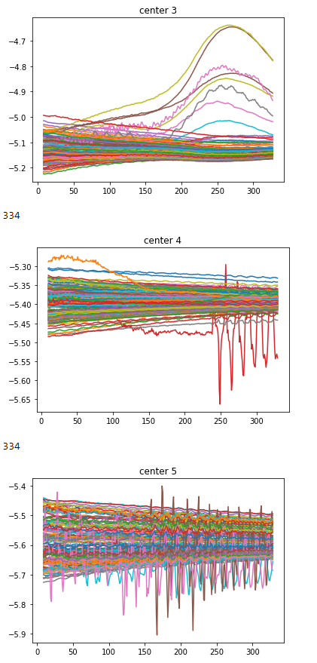
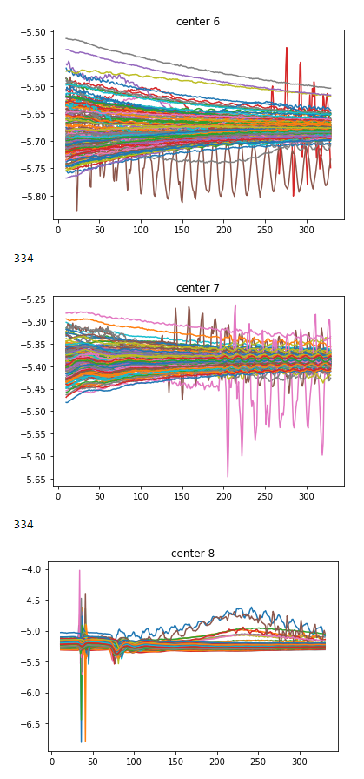
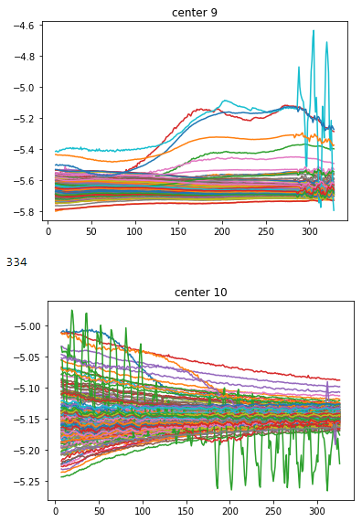
3. Finding concepts
Find different concepts of different anomalies in data
Example: Concepts in EE plateaus of U_diode PM
2D-tSNE axis 2
2D-tSNE axis 1

Slide 15
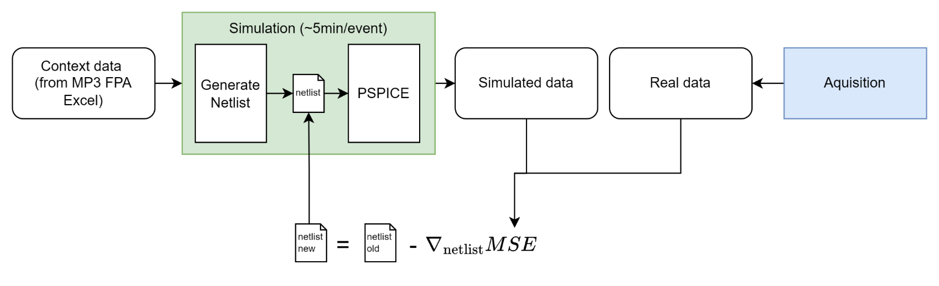
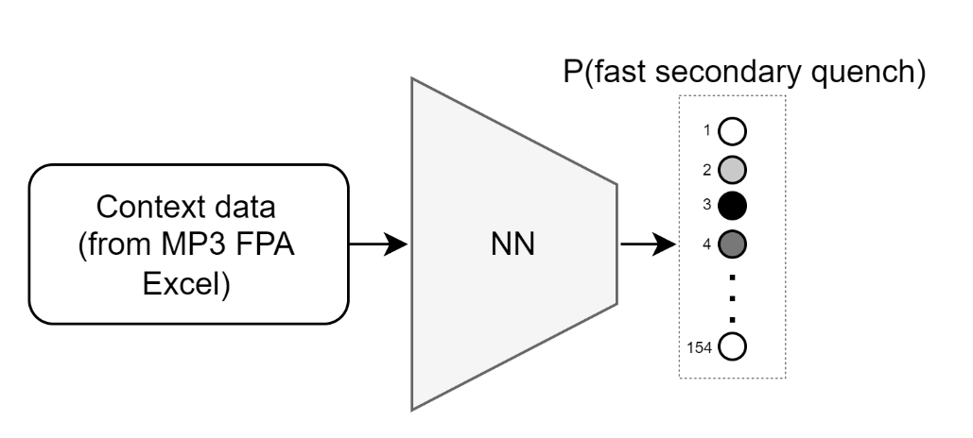
4. Predict parameters
a.) Neural netlist optimization: Improve simulations with gradient descent
b.) Predict fast secondary quenches with CLIC approach: Use Explainable AI to see what the NN was looking at

Slide 16
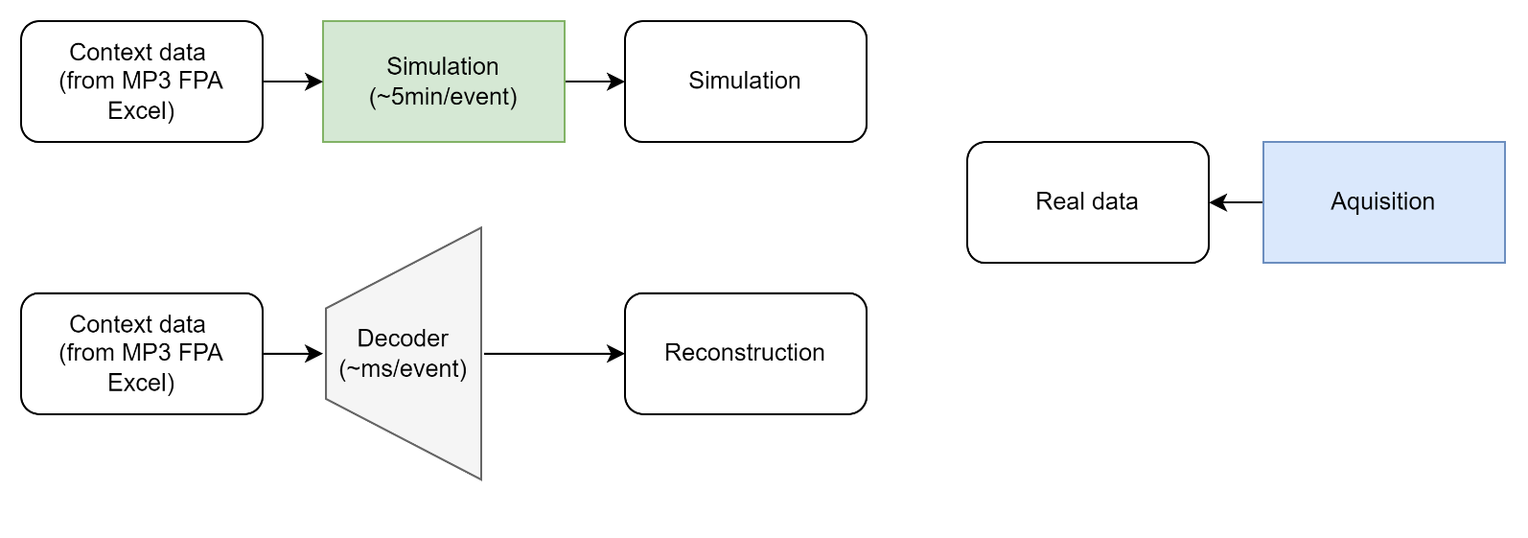

5. Generate data
Can ML generate data faster/more accurate than simulations? Using the same input
Optimization of decoder weights with MSE between real data and simulated data
Advantages:
Decoder can create within seconds, more similar to real data
Detection of anomalies with MSE
Disadvantage: Black box

Slide 17
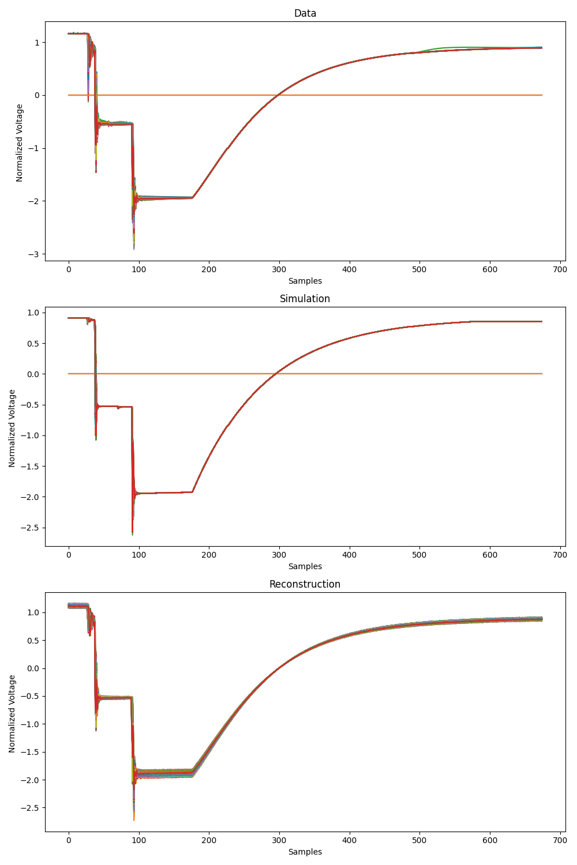
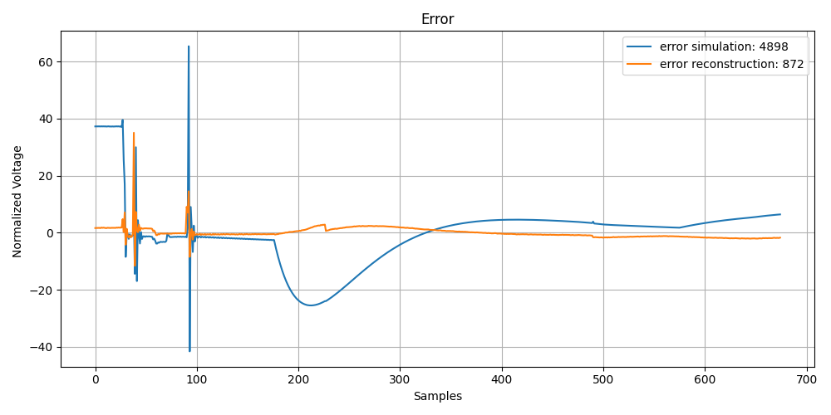
5. Generate data
Can ML generate data faster/more accurate than simulations?

Slide 18
Discussion
Feature analysis:
Analyze both EE sunglasses, dependent on threshold, also within event
Find probabilities:
How does the dstd score evolve in B28L8, do other magnets evolve similarly?
Find concepts:
tSNE per magnet
Predict parameters:
Optimization of magnet parameter
Generate data:
Simulation data will be improved
Also use: UQS0, Voltage feelers, Quench heaters

